Slide 1
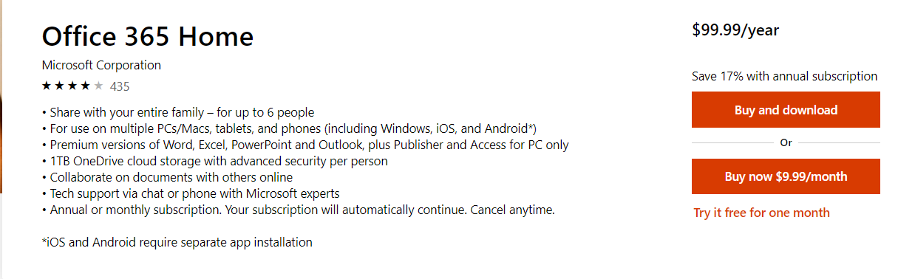
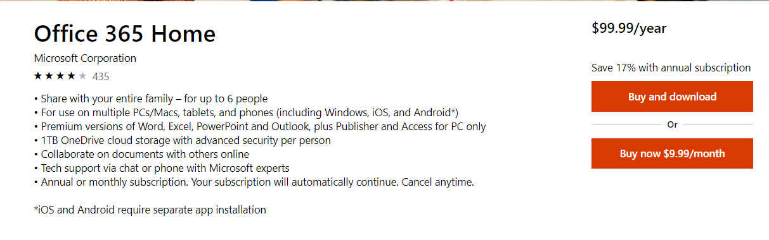
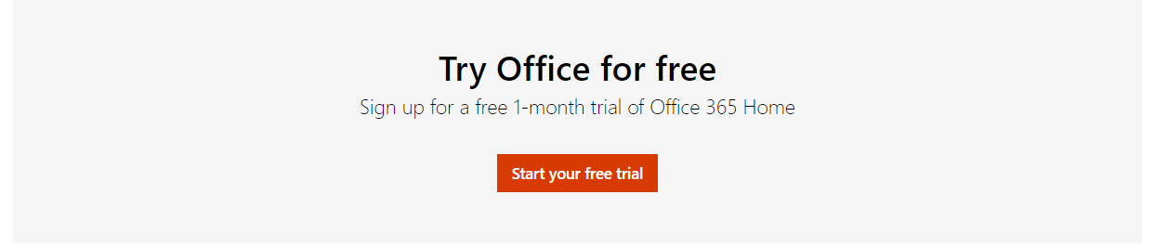
Test Overview
Control – with Trial link
Goal | Increase Office Order rate
Hypothesis | If we removed the free trial link from the O365 Home and Personal Buy Box, but placed it at the bottom of the page as well as in a pop-up modal if user is leaving the page/closing the browser, then Office order rate will increase because customers will opt to order immediately instead, and mitigate the potential overall Trial abandonment from removing the Trial altogether. .
Test Page URL(s) | Office 365 Home & Personal PDPs:
Markets | EN-US, EN-CA
Test Dates | 5/22/2019 – 6/24/2019
KPIs | Primary KPI: Office Orders; Secondary KPI: Office Funnel
Minimum Detectable Effect (MDE) | 3%
Channels | Desktop, Tablet, Mobile
VSO Ticket # | 21560219
Variant – Moved Trial link to page bottom
Notes:
Note:
As per 20356404 – ‘SurfaceGo’ redirected in AU/SG to ‘Surface Go bundle’ from 3/17-3/29 which will impact to reporting for this test during the period of time.
For US and CA - excluded SurfaceGo and Surface Pro as per experiment.

Slide 2
Want to understand user intent when they come to PDP. Are they more ready to buy (and the trial link was a distraction so that they didn't buy right away) or were they not apt to buy and trial was a good offer?
Q – Buy and try user characteristics based on historical data. If a user matches buy traits, then ready to BUY. If a user matches, TRY traits the ready to TRY. Capture buy and try rate.
Context
If we have more people that are ready to buy, for example, then moving trial lower on page might actually be a good thing to increase Orders.
Q– during test period, did the user base for BUY traits increased ? Compare with historical data.
But if we can figure out if users are more in browsing and not ready to buy, that this group may have converted on Trial more - but now that we moved it and made it less visible, it was a bad thing.
Q- during test period did TRY’s user base increase ?
Impact
Science
Analyze O366 Home Unique users (2k) with Paid (300), Free(100) or no Purchase
K-mean clustering to segment store users based on
19+ behavior signals
Source: Adobe/EXP/Clicktale

Slide 3

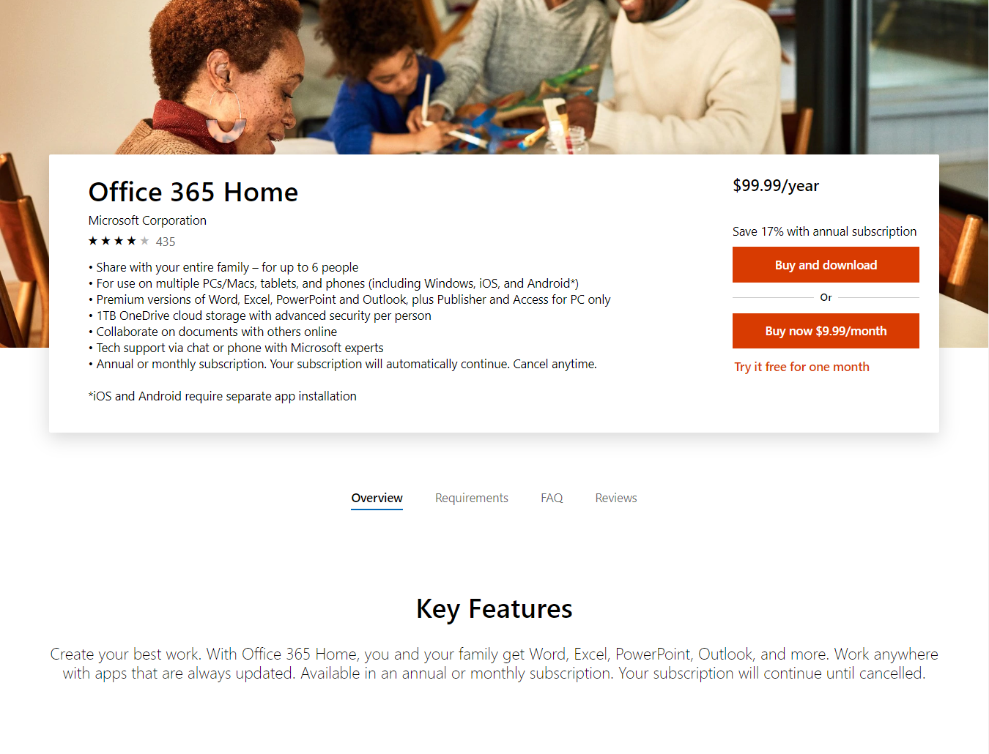


Study customer behavior and intent to Buy or Try Office product
Context
O&O
Direct
Organic Search
Traffic Channel
Office.com
Store
O365 Web
Entry Domain
New Visitor
Return Visitor
Source: Adobe/EXP/Clicktale

Slide 4
O365 Home – User Features with Buy and Try (Pre-Test Period)
Page engagement at HIT level
Before test buy Rate is 8% and try Rate is 2%
Most traffic comes from Store at 2.95% for Buy and 1.01% for Try. Followed by O365 Web and Office.com
Traffic entering as ‘Direct’ buys most at 2.79% while Paid traffic Trys most at 0.58%
Both Buys and Trys interact with TechSpecs tab, interesting to note that Buys
Source: Adobe/EXP/Clicktale

Slide 5
O365 Home – Pre-Test vs. Test Period
Buy Rate dropped at -9.5% as users who were interacting with “trial” link before placing the order
The drop was among all Entry except ‘Store’
There was uniform drop across all Traffic Channel
Source: Adobe/EXP/Clicktale

Slide 6
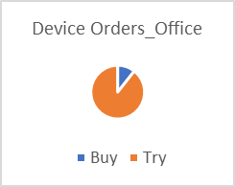
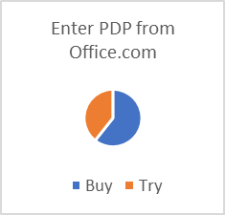
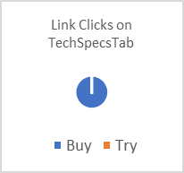
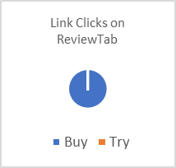
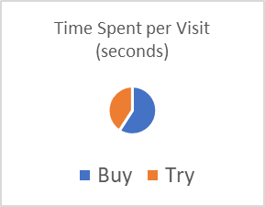
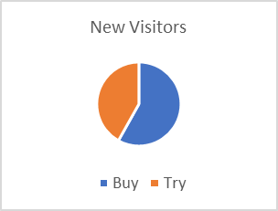
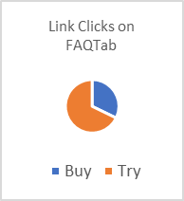
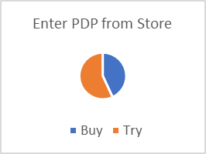
Buy vs Try Orders
Buy
Try
Users with devices go for Try [assume with device will not have Office]
New Visitors tend to Buy [ excludes devices]
Buy is more for users entering from Office.com and Try for users from Store
Buyers spend more time per Visit
Buyers interact with all Tabs while Tryers only look at ‘FAQ’.
New/Return
Tabs Engagement
Entry Path
Engagement
Source: Adobe/EXP/Clicktale

Slide 7
Buy Intent
US – O365 Home PDP: Buy Intent
Does not has Hardware device purchase from MS Store, (add context )
Average Visits >1
Tend to be New visitors
More likely to come from MS Store or O365 Web
Average Time spent per Visit 597 secs
Avg time on O365 Home PDP page 82 sec
Avg 38 Clicks on the page, may see Tech-Specs, Review and FAQ tab
Features | Buy Average
Device Orders | 0.01
Total Visits | 1.07
New Visitors | 0.66
Enter PDP from Office.com | 0.07
Enter PDP from Store | 0.36
Enter PDP from O365 Web | 0.32
Time Spent per Visit (seconds) | 597.01
Average Time Spent on Page (seconds) | 82.69
Link Clicks (e4) | 38.84
Link Clicks on TechSpecsTab | 0.02
Link Clicks on ReviewTab | 0.01
Link Clicks on FAQTab | 0.01
Link Clicks on AddtoCartButton | 0.29
Link Clicks on Trial link | 0.13
Centroid Values (Standardized)
 | Device Orders_Office | Total Visits | New Visitors | Enter PDP from Office.com | Enter PDP from Store | Enter PDP from O365 Web | Time Spent per Visit (seconds)
Buy | -0.65 | -0.07 | -0.06 | -0.17 | 0.03 | -0.02 | -0.03
Source: Adobe/EXP/Clicktale

Slide 8
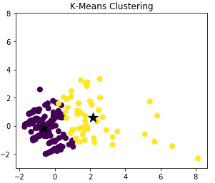
Try Intent
Try
Buy
US – O365 Home PDP: Try Intent
May have Hardware device from MS
Average Visits >1
Higher for Return visitors
More likely to come from MS Store
Average Time spent per Visit 412 secs
Avg time on O365 PDP page 73 sec
Avg 27 Clicks on the page, may see FAQ tab
Features | Try Average
Device Orders_Office | 0.10
Total Visits | 1.07
New Visitors | 0.48
Enter PDP from Office.com | 0.05
Enter PDP from Store | 0.48
Enter PDP from O365 Web | 0.31
Time Spent per Visit (seconds) | 412.36
Average Time Spent on Page (seconds) | 73.86
Link Clicks (e4) | 27.02
Link Clicks on TechSpecsTab | 0.00
Link Clicks on ReviewTab | 0.00
Link Clicks on FAQTab | 0.02
Link Clicks on AddtoCartButton | 0.14
Link Clicks on Trial link | 0.02
Centroid Values (Standardized)
 | Device Orders_Office | Total Visits | New Visitors | Enter PDP from Office.com | Enter PDP from Store | Enter PDP from O365 Web | Time Spent per Visit (seconds)
Try | 2.17 | 0.23 | 0.19 | 0.57 | -0.10 | 0.07 | 0.09
Source: Adobe/EXP/Clicktale

Slide 9
Appendix

Slide 10
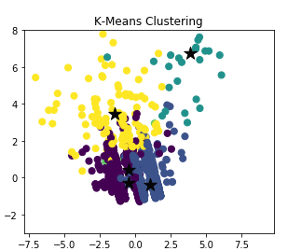
Users behavior
Try
Buy
New Visitor – intending for Buy or Try, coming from O365 web, medium page and tabs engagement.
Return Visitors intending to buy, coming from store, spends less time on page, medium engaged on all tabs
Return visitors, browsing mode as confused and does not buys, spends time browsing content on each visit. Highly engaged. Low traffic.
Return Visitors with a Device, both buy and try intent, engaged during the entirety of the Visit, though less time on Office PDP page. Low traffic.
Both New and Return visitor heavily engaged on Office PDP having high Buy intent.
 |  | Centroid Values (Standardrized)
Cluster |  | Paid Order Exists | Try Exists | Device Orders_Office | Total Visits | New Visitors | Enter PDP from Office.com | Enter PDP from Store | Enter PDP from O365 Web
1 | New visitor: Buy/Try | -0.25 | -0.31 | -0.46 | -0.07 | -0.01 | -0.16 | -0.12 | 0.12
2 | Return vistor: Buy | -0.36 | 0.61 | 1.07 | 0.09 | 0.16 | 0.22 | 0.10 | -0.31
3 | Return Visitors : Browsing Mode | 6.77 | -5.94 | 3.87 | -1.91 | -1.16 | -1.03 | 0.40 | -0.26
4 | Return visitors with Device: Buy/Try | 0.45 | -0.42 | -0.48 | 1.91 | -3.95 | 8.75 | 3.45 | 6.69
5 | High Engaged: Buy | 3.48 | 1.72 | -1.41 | 0.60 | -0.13 | -0.11 | 0.33 | -0.41
Features | Cluster 1 | Cluster 2 | Cluster 3 | Cluster 4 | Cluster 5
Paid Order Exists | 0.08 | 0.12 | 0.04 | 0.25 | 0.14
Try Exists | 0.02 | 0.03 | 0.00 | 0.25 | 0.08
Device Orders_Office | 0.00 | 0.00 | 0.00 | 1.00 | 0.01
Total Visits | 1.08 | 1.10 | 1.18 | 1.00 | 1.49
New Visitors | 0.65 | 0.36 | 0.39 | 0.33 | 0.52
Return Visitors | 0.35 | 0.64 | 0.61 | 0.67 | 0.48
Enter PDP from Office.com | 0.04 | 0.07 | 0.14 | 0.08 | 0.12
Enter PDP from Store | 0.08 | 0.61 | 0.32 | 0.17 | 0.43
Enter PDP from O365 Web | 0.67 | 0.06 | 0.36 | 0.42 | 0.45
Time Spent per Visit (seconds) | 452.69 | 418.72 | 653.66 | 686.09 | 664.64
Average Time Spent on Page (seconds) | 107.91 | 86.94 | 94.66 | 39.13 | 185.68
Link Clicks (e4) | 19.15 | 20.78 | 31.71 | 31.08 | 32.52
Link Clicks on OverviewTab | 0.01 | 0.01 | 0.04 | 0.00 | 0.00
Link Clicks on TechSpecsTab | 0.03 | 0.03 | 0.07 | 0.00 | 0.03
Link Clicks on ReviewTab | 0.01 | 0.02 | 0.07 | 0.00 | 0.00
Link Clicks on FAQTab | 0.02 | 0.01 | 0.04 | 0.00 | 0.02
Link Clicks on AddtoCartButton | 0.17 | 0.20 | 0.18 | 0.08 | 0.24
Link Clicks on Trial link | 0.12 | 0.10 | 0.07 | 0.25 | 0.00
Source: Adobe/EXP/Clicktale

